Slide 1
Онлайн
образование
otus.ru

Slide 2



Проверить, идет ли запись
Меня хорошо видно
&& слышно?

Slide 3

Построение обратной петли (feedback loop)
Тема вебинара
Анатолий Бурнашев
эксперт SRE 20+ лет в коммерческом IT
tg.me/ayburnashe

Slide 4
Маршрут вебинара
Частичная перепроверка
Пересчет метрик качества
Мониторинг метрик качества
Существующие решения
Заключение

Slide 5
Цели вебинара
После занятия вы сможете
1. | Измерять метрики качества на проде
2. | Визуализировать их в онлайне
3. | Использовать мониторинг для автоматического переобучения

Slide 6
Смысл
Зачем вам это уметь
1. | Со временем качество многих моделей деградирует
2. | При инференсе обычно не известно значение целевой переменной

Slide 7
Частичная перепроверка

Slide 8
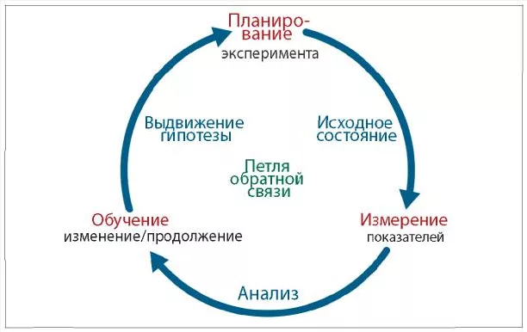
Петля обратной связи

Slide 9
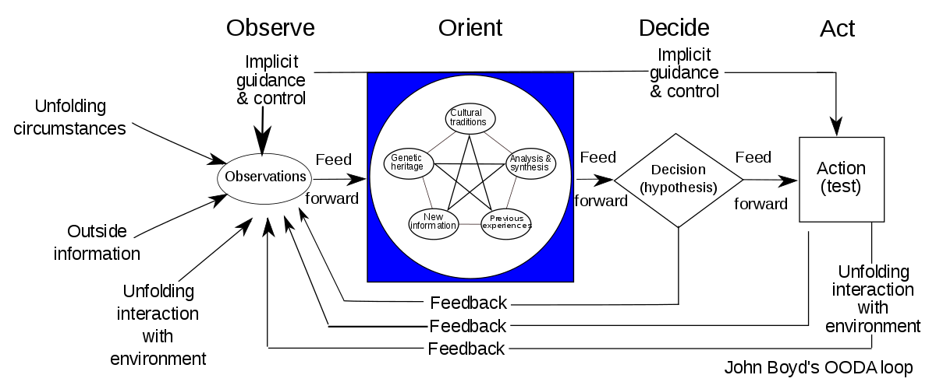
OODA Loop
Notes:
The OODA loop (observe, orient, decide, act) was developed by military strategist and United States Air Force Colonel John Boyd. He applied the concept to the combat operations process, often at the operational level during military campaigns. It is often applied to understand commercial operations and learning processes. The approach explains how agility can overcome raw power in dealing with human opponents. It is especially applicable to cyber security and cyberwarfare.^{[1]}
The OODA loop has become an important concept in litigation,^{[2]} business,^{[3]} law enforcement,^{[4]} management education,^{[5]} and military strategy. According to Boyd, decision-making occurs in a recurring cycle of "observe, orient, decide, act". An entity (whether an individual or an organization) that can process this cycle quickly, observing and reacting to unfolding events more rapidly than an opponent, can thereby get inside the opponent's decision cycle and gain the advantage.
The Chief Advisor to the UK Prime Minister Dominic Cummings credits the success of the Vote Leave campaign in the 2016 United Kingdom European Union membership referendum to its faster processing of OODA loops, along with the focus of Vote Leave on disrupting the OODA loops of the opposing Britain Stronger in Europe campaign team.^{[6]}

Slide 10
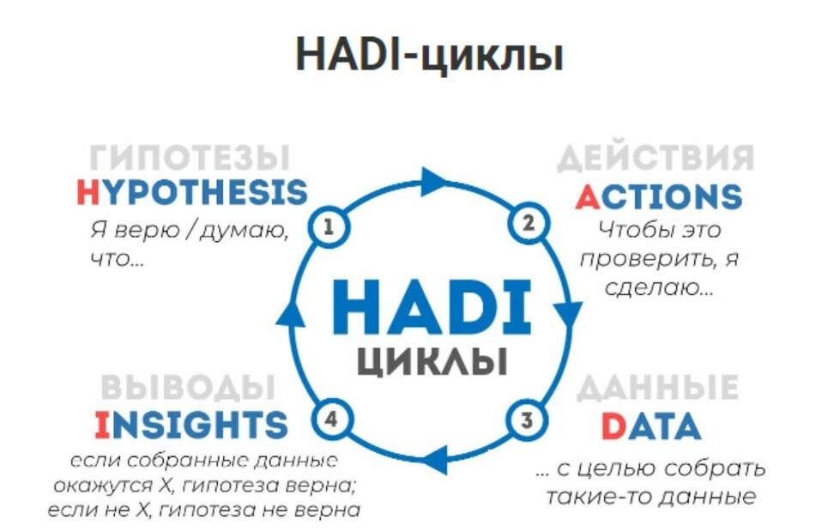
HADI

Slide 11
Частичная перепроверка
Все скоры модели сохраняются в БД
Часть новых данных периодически отправляется на ручную разметку
для оценки метрик выбираются случайные объекты за интервал
для обогащения обучающей выборки выбираются объекты с пограничными вердиктами (active learning)
В интерфейсе модели предусмотрен ответ “Я не знаю”
при таком вердикте объект отправляется на ручную обработку
для некоторой доли уверенных ответов “Я не знаю” проставляется случайным образом
на основе ручной разметки для новых данных периодически пересчитываются метрики качества за выбранных период

Slide 12
Объем ручной перепроверки
Плюсы большого объема:
маленький доверительный интервал для важных метрик
большая скорость роста обучающей выборки
быстрое изменение метрик со временем
Минусы большого объема:
только небольшая часть работы оказывается автоматизирована
большой объем ручной работы по перепроверке

Slide 13
Рекомендации по выбору объема
требования к величине доверительного интервала для метрик
ограничения на объем ручной перепроверки
желаемое время обнаружения деградации модели

Slide 14
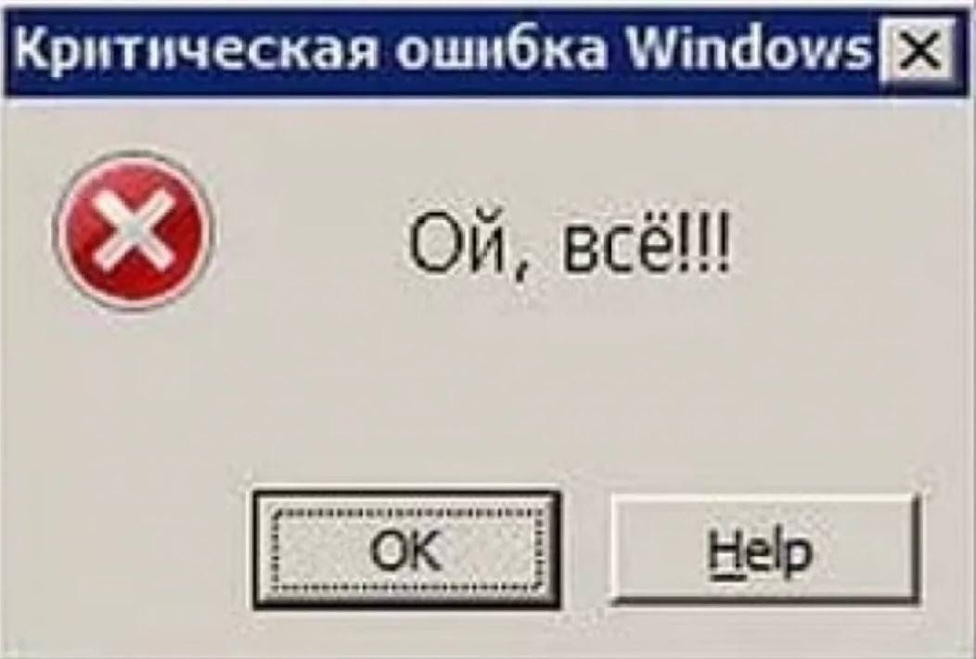

Slide 15
SLx
SLA
SLO
SLI

Slide 16
Пересчет метрик качества

Slide 17
Сервис расчета метрик
периодически ходит в БД и забирает все объекты с ручной разметкой за выбранное время и вердикты модели
вычисляет необходимые метрики
сохраняет их в БД или отдает системе мониторинга
отдельный дашборд настроен для визуализации метрик во времени

Slide 18


Slide 19


Схема взаимодействия
ML service
objects
scores
metrics
graphs
Scores and labels
Metrics service
DS
labels
expert

Slide 20


Slide 21
Ваши вопросы?
Экспертиза - необходима
Skynet - подождет
Но автоматизация помогает

Slide 22
Мониторинг метрик качества

Slide 23
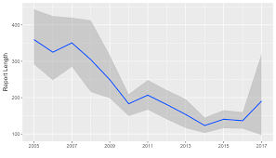
Визуализация
За разные интервалы времени может быть разное число примеров
Удобно визуализировать доверительный интервал
Строить метрики качестве в необходимых разрезах
Подписывать версии моделей

Slide 24
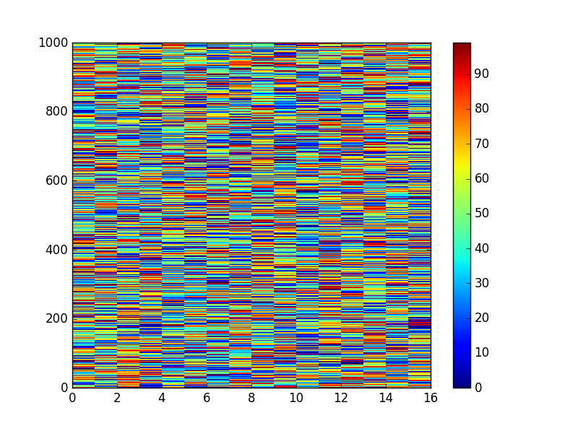
Больше BI! Больше метрик!

Slide 25
Существующие решения

Slide 26
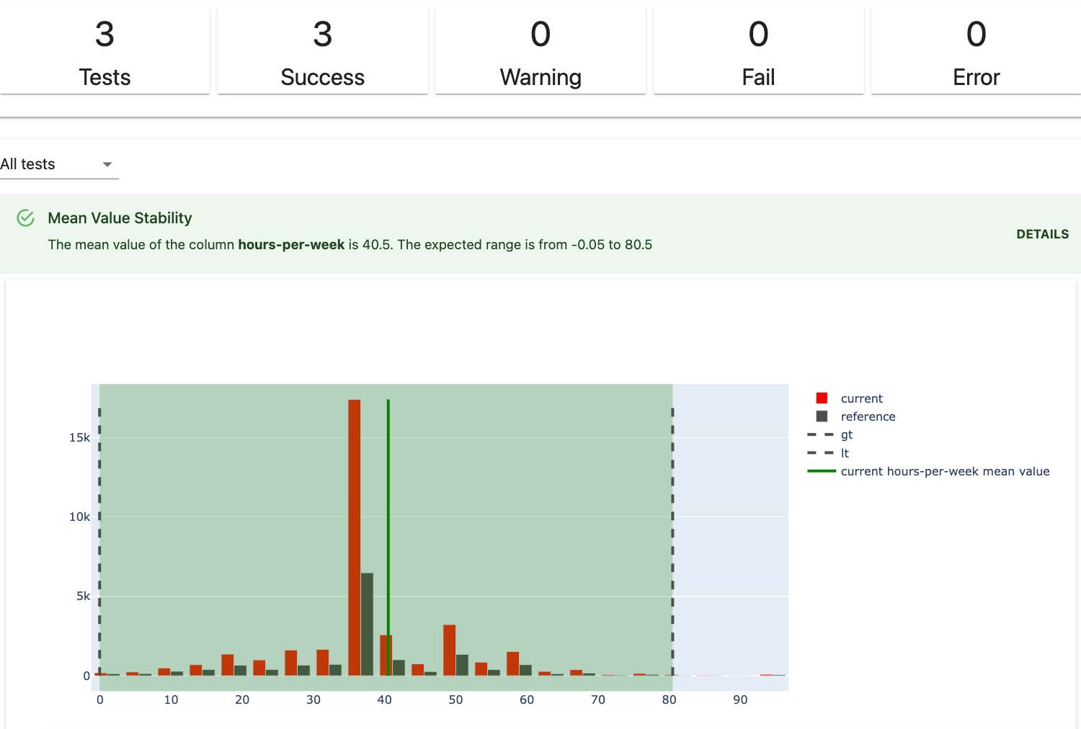
Evidently AI
Notes:
How it works
Evidently helps evaluate and test data and ML model quality throughout the model lifecycle.
Evidently has a modular approach with 3 components: Reports, Test Suites, and a Monitoring Dashboard. They cover different usage scenarios: from ad hoc analysis to automated pipeline testing and continuous monitoring.
Evidently has a simple, declarative API and a library of in-built metrics, tests, and visualizations.
1. Tests suites: batch model checks
Tests perform structured data and ML model quality checks. You can set the conditions manually or let Evidently generate them based on the reference dataset. Tests will return an explicit pass or fail result.
You can create a Test Suite from 50+ tests or run one of the Presets. For example, to test Data Stability or Regression Performance.
Tests are best for automated batch checks.
How you get the output: inside Jupyter notebook or Colab, as an exportable HTML, JSON, or Python dictionary.
Primary use case: test-based ML monitoring. You can run tests as a step in the ML pipeline. For example, when you receive a new batch of data, labels, or generate predictions. You can build a conditional workflow based on the results, e.g., to trigger an alert, retrain, or get a report.
Read more:
Overview: what is a test and a test suite
User guide: how to generate tests
Reference: available tests and presets

Slide 27
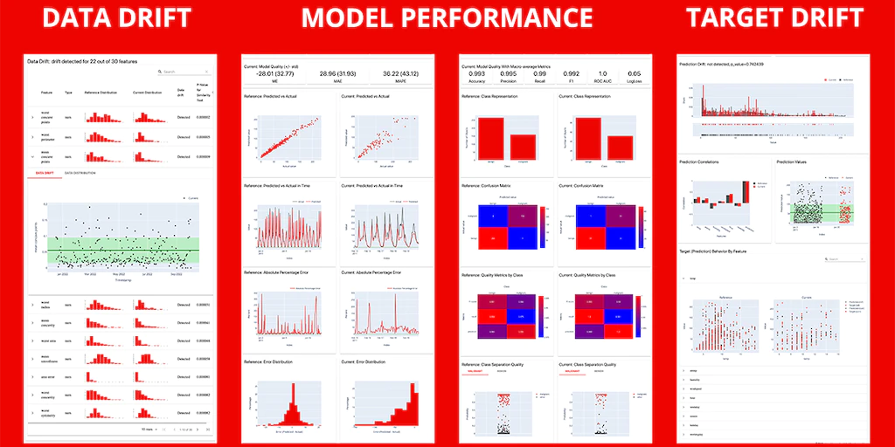
Evidently AI
Notes:
How it works
Evidently helps evaluate and test data and ML model quality throughout the model lifecycle.
Evidently has a modular approach with 3 components: Reports, Test Suites, and a Monitoring Dashboard. They cover different usage scenarios: from ad hoc analysis to automated pipeline testing and continuous monitoring.
Evidently has a simple, declarative API and a library of in-built metrics, tests, and visualizations.
2. Reports: interactive visualizations
Reports calculate various metrics and provide rich interactive visualizations.
You can create a custom Report from individual metrics or run one of the Presets that cover a specific aspect of the model or data performance. For example, Data Quality or Classification Performance.
Reports are best for exploratory analysis, debugging, and documentation.
Input: one or two datasets as pandas.DataFrames or csv.
How you get the output: inside Jupyter notebook or Colab, as an exportable HTML file, JSON, or Python dictionary.
Primary use case: analysis and exploration. Reports help visually evaluate the data or model performance. For example, during exploratory data analysis, model evaluation on the training set, when debugging the model quality decay, or comparing several models.
Secondary use cases:
Reporting and documentation. You can generate visual HTML reports and ML model cards.
Performance logging. You can integrate an evaluation step in the data/ML pipeline, get outputs as JSON, and log it for further analysis or to visualize using BI tools.
Input: one or two datasets as pandas.DataFrames or csv.
How you get the output: inside Jupyter notebook or Colab, as an exportable HTML file, JSON, or Python dictionary.
Primary use case: analysis and exploration. Reports help visually evaluate the data or model performance. For example, during exploratory data analysis, model evaluation on the training set, when debugging the model quality decay, or comparing several models.
Secondary use cases:
Reporting and documentation. You can generate visual HTML reports and ML model cards.
Performance logging. You can integrate an evaluation step in the data/ML pipeline, get outputs as JSON, and log it for further analysis or to visualize using BI tools.
3. ML monitoring dashboard
Available starting from v0.4.0.
You can self-host an ML monitoring dashboard to visualize metrics and test results over time. This functionality sits on top of Reports and Test Suites. You must store their outputs as Evidently JSON snapshots that serve as a data source for the Evidently Monitoring UI.
You can visualize any and track 100+ metrics available in Evidently, from number nulls in data to text sentiment and embedding drift
Input: Evidently snapshots, logged to an object storage.
Output: a self-hostable dashboard available as a web app.
Primary use case: continuous monitoring. When you need a live dashboard to see all your models and metrics over time.

Slide 28
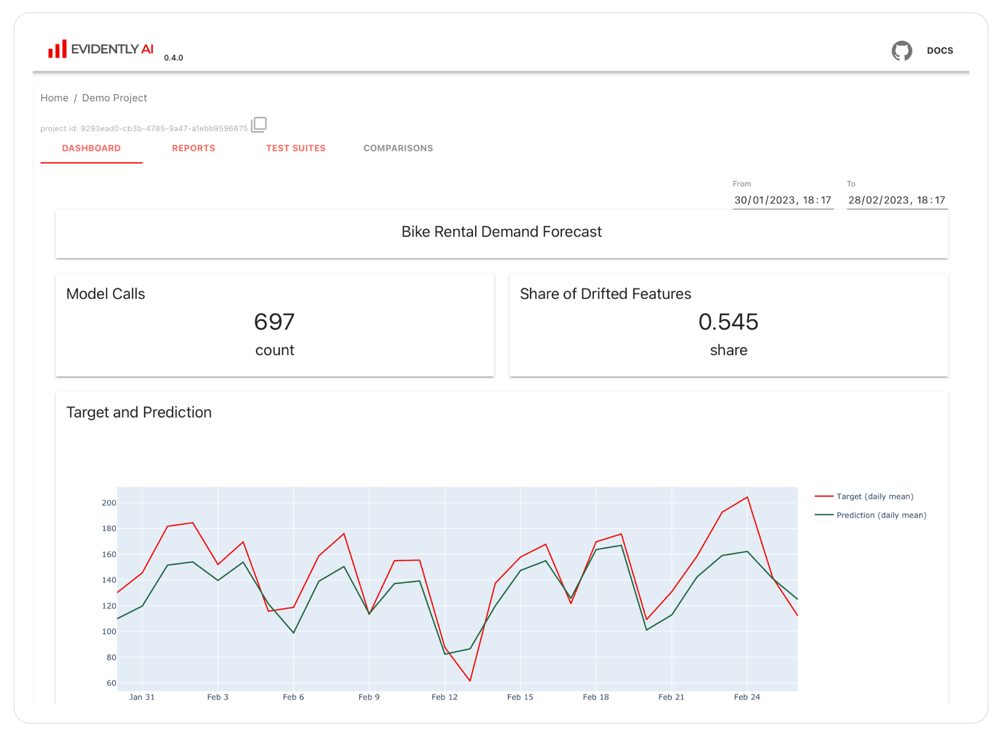
Evidently AI
Notes:
How it works
Evidently helps evaluate and test data and ML model quality throughout the model lifecycle.
Evidently has a modular approach with 3 components: Reports, Test Suites, and a Monitoring Dashboard. They cover different usage scenarios: from ad hoc analysis to automated pipeline testing and continuous monitoring.
Evidently has a simple, declarative API and a library of in-built metrics, tests, and visualizations.
3. ML monitoring dashboard
Available starting from v0.4.0.
You can self-host an ML monitoring dashboard to visualize metrics and test results over time. This functionality sits on top of Reports and Test Suites. You must store their outputs as Evidently JSON snapshots that serve as a data source for the Evidently Monitoring UI.
You can visualize any and track 100+ metrics available in Evidently, from number nulls in data to text sentiment and embedding drift
Input: Evidently snapshots, logged to an object storage.
Output: a self-hostable dashboard available as a web app.
Primary use case: continuous monitoring. When you need a live dashboard to see all your models and metrics over time.

Slide 29
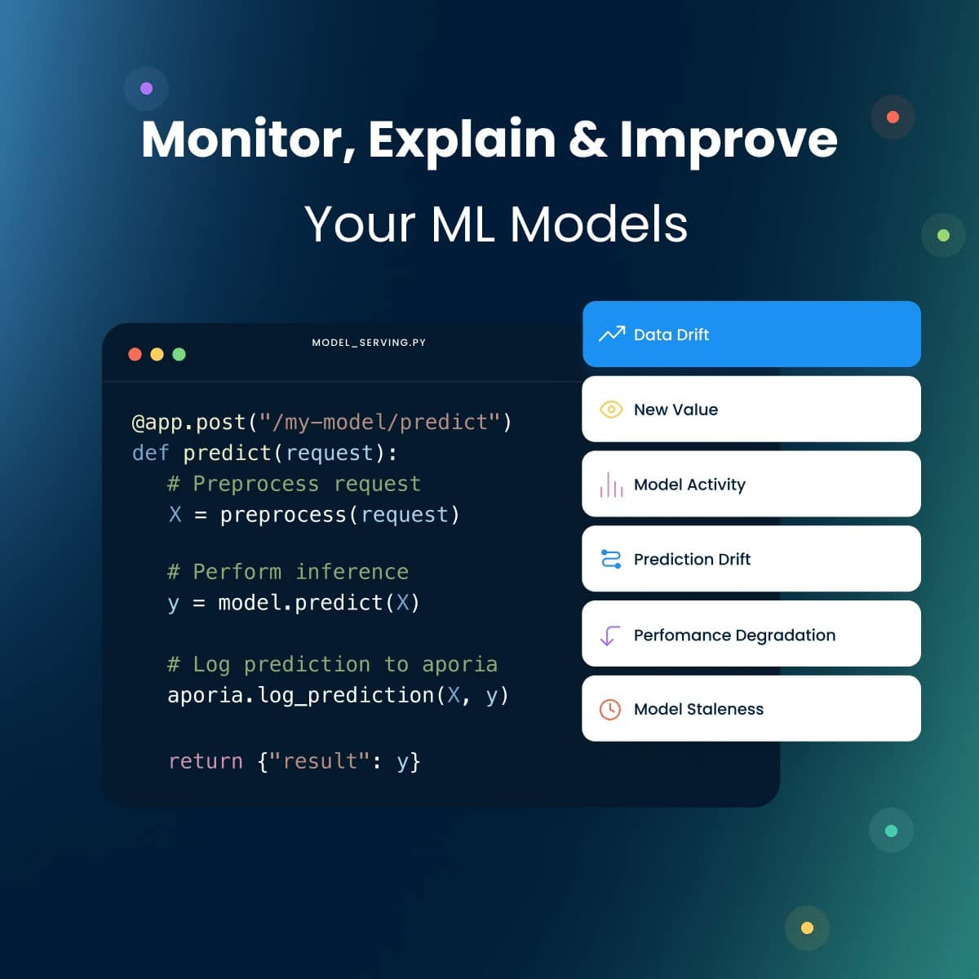
Aporia
Notes:
Monitoring models has never been easier
Simple setup with segment-level monitoring ready in minutes
Monitor drift, performance, and data quality across diverse model types, from LLMs to traditional ML.
Gain peace of mind with automated monitoring of your models, data schema, and features.
Focus on building models, let Aporia’s model monitoring do the leg work for you.
Handling billions of predictions? Rest assured that every single prediction is monitored, leaving no room for errors or sampling.

Slide 30
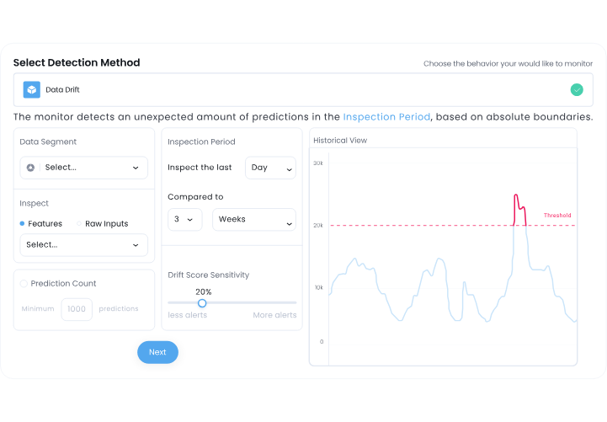
Aporia
Notes:
Full customization: Your model, your rules.
Tailor ML monitoring to your unique challenges and use case.
Monitor metrics tailored to your needs, leveraging an SQL-like query for deriving new metrics.
Benefit from continuous auto-thresholding, making the monitoring system highly practical and efficient.
Set static thresholds or dynamic ones that are influenced by patterns in the incoming data.
Ensure your monitoring approach remains dynamic, adapting to your model’s evolving needs.

Slide 31
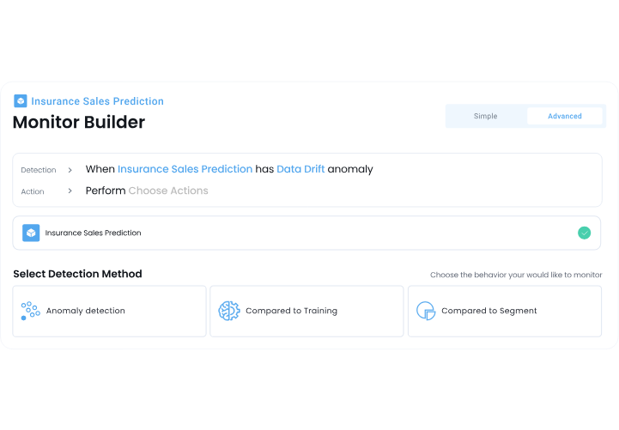
Aporia
Notes:
Examine different environments & versions
Dive deep into the nuances of your models and compare behaviours across datasets & versions
Analyze and compare performance shifts across training, validation, and production datasets.
Leverage native A/B testing tools to easily identify and confirm any variations in the model’s performance.
Monitor your model’s progression and behavior across various versions and updates.

Slide 32
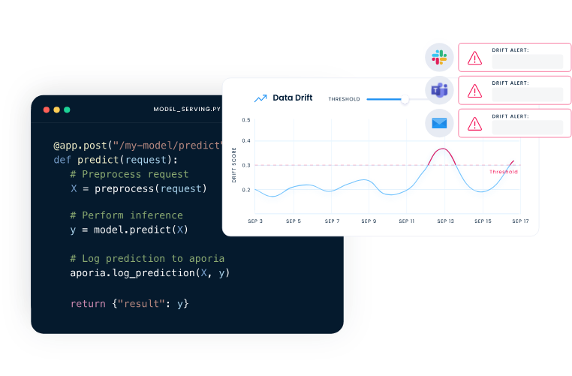
Aporia
Notes:
Alerts, on your terms
Get instant notifications to your preferred communication channels.
Choose from a range of alerting options, from emails and MS Teams to Slack notifications.
Define urgency thresholds to avoid alert fatigue.
When drift is detected, an investigation case is instantly initiated. The goal is to solve issues, not just point to them.

Slide 33
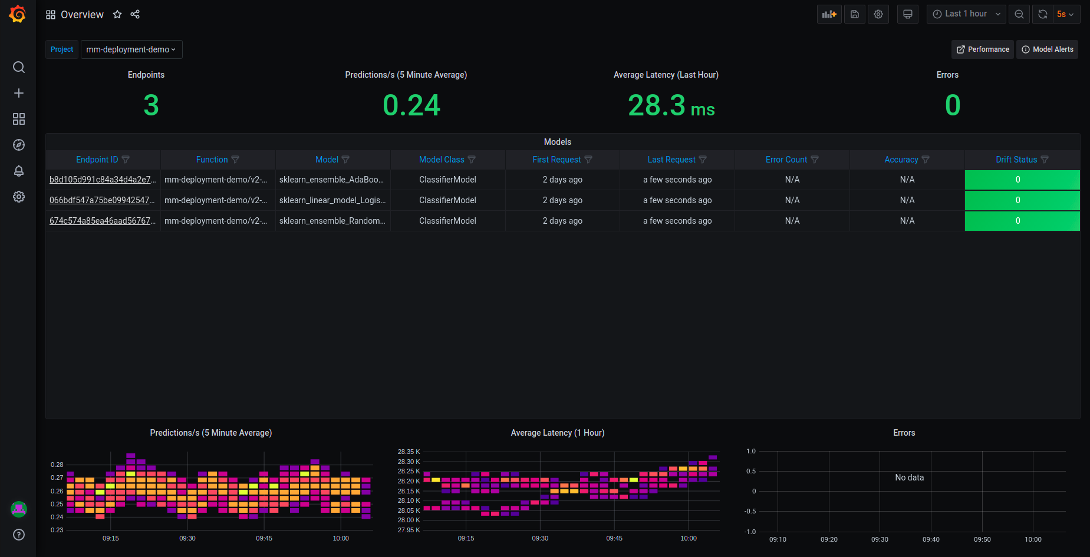
MLRun model monitoring
Notes:
Model monitoring
By definition, ML models in production make inferences on constantly changing data. Even models that have been trained on massive data sets, with the most meticulously labelled data, start to degrade over time, due to concept drift. Changes in the live environment due to changing behavioral patterns, seasonal shifts, new regulatory environments, market volatility, etc., can have a big impact on a trained model’s ability to make accurate predictions.
Model performance monitoring is a basic operational task that is implemented after an AI model has been deployed. Model monitoring includes:
Built-in model monitoring: Machine learning model monitoring is natively built in to the Iguazio MLOps Platform, along with a wide range of model management features and ML monitoring reports. It monitors all of your models in a single, simple, dashboard.
Automated drift detection: Automatically detects concept drift, anomalies, data skew, and model drift in real-time. Even if you are running hundreds of models simultaneously, you can be sure to spot and remediate the one that has drifted.
Automated retraining: When drift is detected, Iguazio automatically starts the entire training pipeline to retrain the model, including all relevant steps in the pipeline. The output is a production-ready challenger model, ready to be deployed. This keeps your models up to date, automatically.
Native feature store integration: Feature vectors and labels are stored and analyzed in the Iguazio feature store and are easily compared to the trained features and labels running as part of the model development phase, making it easier for data science teams to collaborate and maintain consistency between AI projects.

Slide 34
MLRun model monitoring - drift detection
Notes:
The Overview pane provides details about the performance of all the deployed and monitored models within a project. You can change projects by choosing a new project from the Project dropdown. The Overview dashboard displays the number of endpoints in the project, the average predictions per second (using a 5-minute rolling average), the average latency (using a 1-hour rolling average), and the total error count in the project.
Additional details include:
Endpoint ID — the ID of the deployed model. Use this link to drill down to the model performance and details panes.
Function — the MLRun function to access the model
Model — user defined name for the model
Model Class — the implementation class that is used by the endpoint
First Request — first request for production data
Last Request — most recent request for production data
Error Count — includes prediction process errors such as operational issues (for example, a function in a failed state), as well as data processing errors (for example, invalid timestamps, request ids, type mismatches etc.)
Accuracy — a numeric value representing the accuracy of model predictions (N/A)
Drift Status — no drift (green), possible drift (yellow), drift detected (red)
At the bottom of the dashboard are heat maps for the Predictions per second, Average Latency and Errors. The heat maps display data based on 15 minute intervals. See How to Read a Heat Map for more details.
Click an endpoint ID to drill down the performance details of that model.

Slide 35
Заключение

Slide 36
Подведем итоги
1. | Вычисление метрик качества в онлайне может быть дорого
2. | Они позволяют обнаружить деградацию качества модели
3. | Существующие решения интегрируются с Grafana

Slide 37


Следующий вебинар
Алертинг
Ссылка на вебинар будет
в ЛК за 15 минут

Slide 38
Заполните, пожалуйста,
опрос о занятии
по ссылке https://otus.ru/polls/65404/

Slide 39
Приходите на следующие вебинары
Спасибо за внимание!
Анатолий Бурнашев
эксперт SRE 20+ лет в коммерческом IT
tg.me/ayburnashe

Slide 40


Вопросы?
Ставим “+”,
если вопросы есть
Ставим “–”,
если вопросов нет

